Slide 1
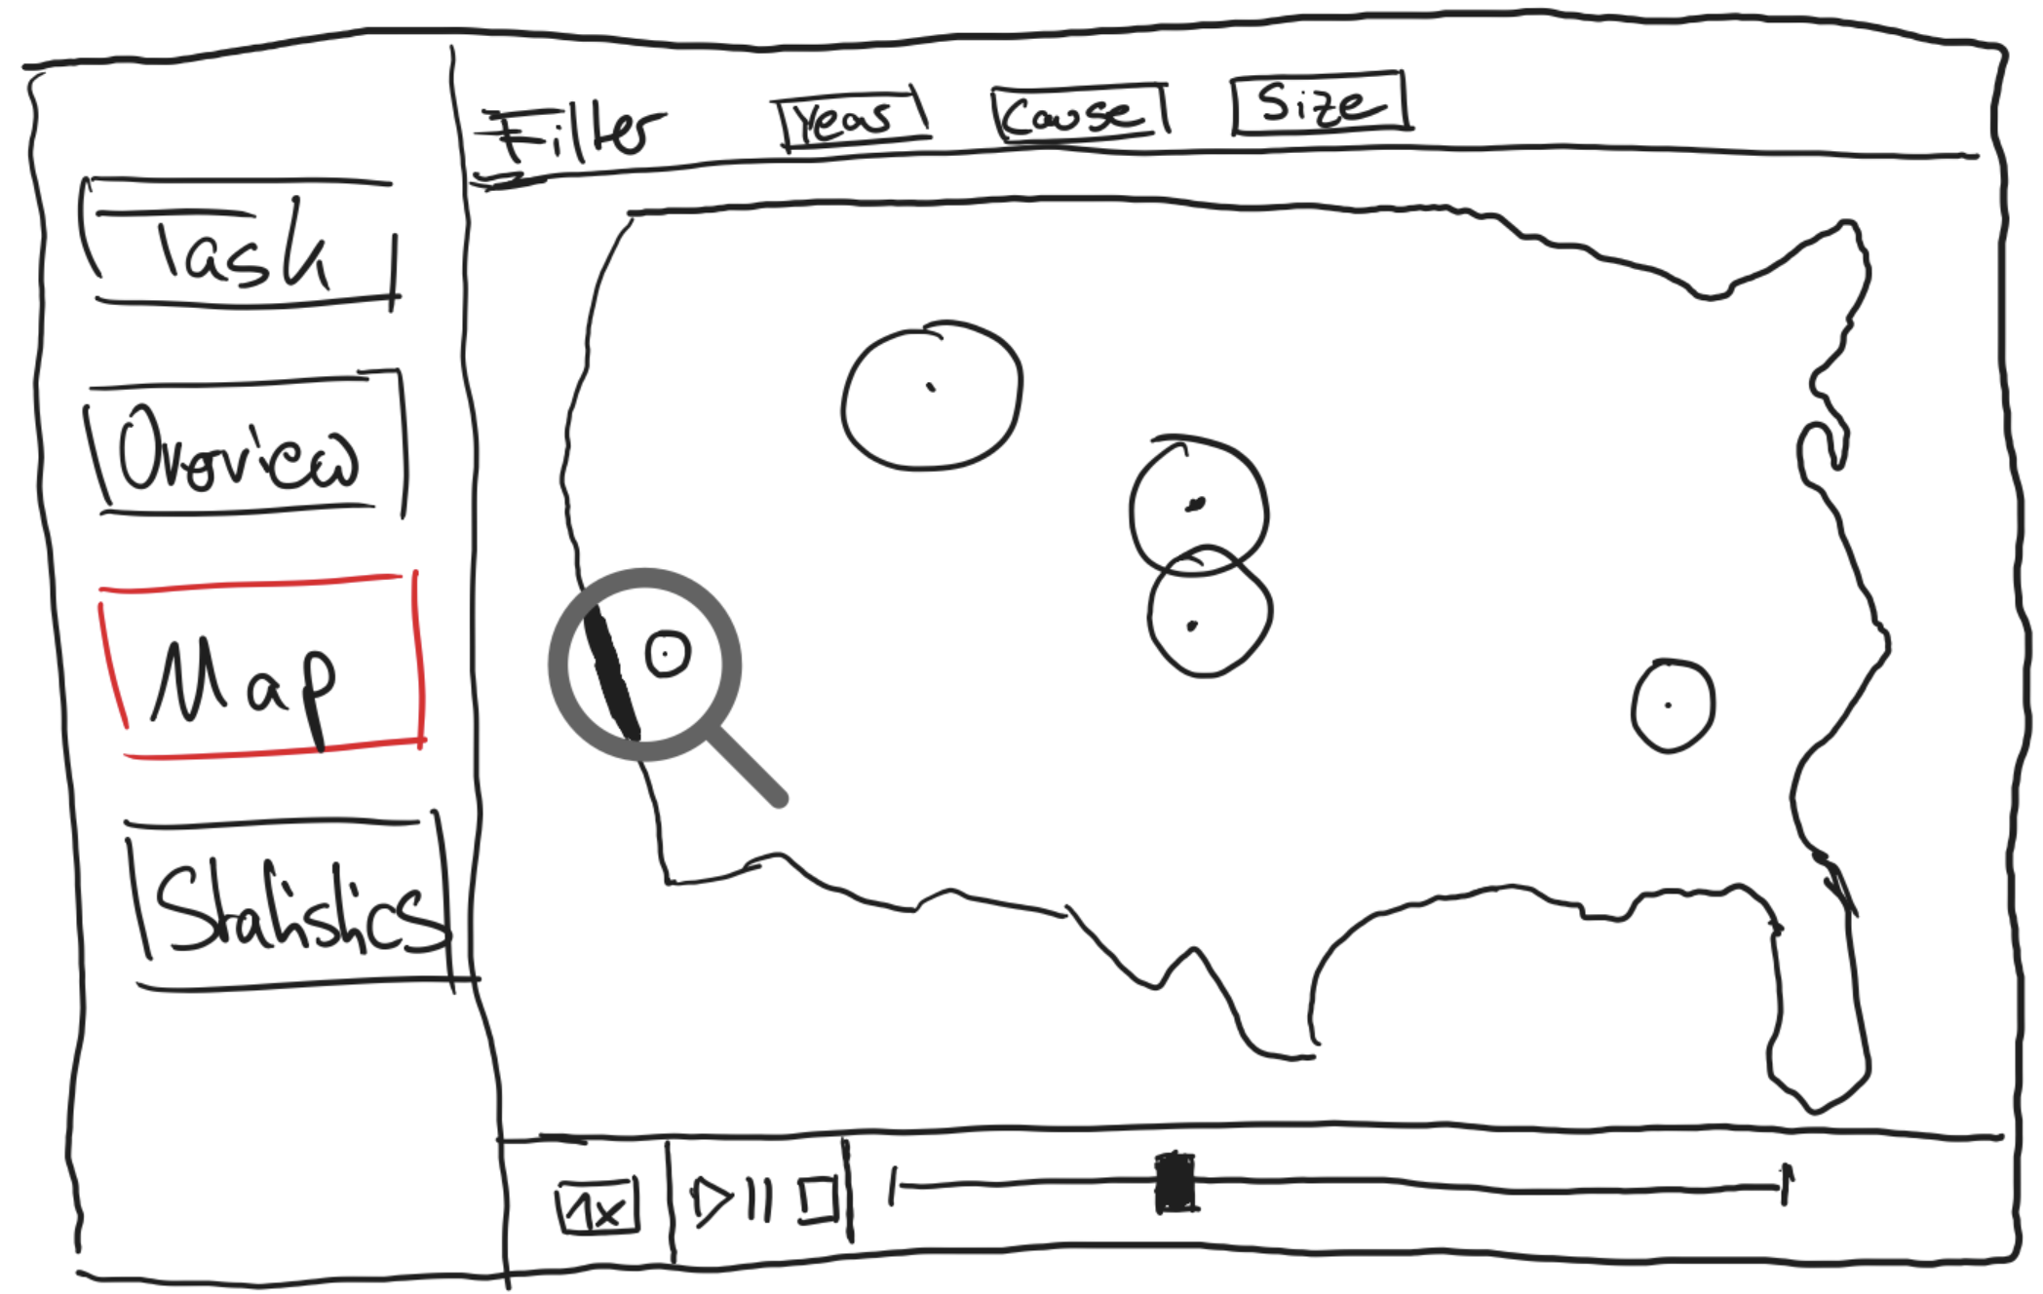
Layout
Information
Author: Pascal Niemann, Tim Cares
Task: Develop an idea for an interactive visualization application
Dataset: 2.3 Million US Wildfires (1992-2020) 6th Edition (Spatial wildfire occurrence data for the United States, 1992-2020)
Some Meta-Data:
Time Range: 1992-2020
Records: 2,3 Million
Burned Acres: 180 Million
Titel: America in flames over the course of time
Date: 11.05.2023
Task: Project VHCI - Develop an idea for an interactive visualization application,
Operations
Left Sidebar:
Click on “Task” button: Changes Window – Display information about this Project and the Task
Click on “Overview”: Changes Window – Display information about the used Dataset and the application
Click on ”Map”: Changes Window – Display Main-Application with a Map of the US and the wildfires.
Click on “Statistics”: Changes Window – Display additional Graphs about the wildfires (optional)
Main-Application Map: Top Bar (Filter)
Enable categorical filters in the map section header to selectively display wildfires based on chosen characteristics:
Year – 1992-2020
Cause – spcific
Size – A-G
Main-Application Map: Lower Bar (Time slider)
Click on “Play”/Dragging the time slider: The wildfires will be dynamically animated for the current chosen filter.
Click on “Pause/Stop” button: pauses/stops the animation with the current given filter.
Click on “1x” button: Display speed options of the wildfire animation. The animation speed adapts to the selection.
Hovering over a wildfire: Reveal additional information such as the affected area, location, and dates of discovery and control.
Main-Application Map:
- Holding Strg+Scroll: Zooming in and out of the map.
Focus / Parti
Core Concept:
Visualization of wildfires in the US in an interactive playable timeline
Information filtering based on:
Width of a specific year or all years compressed
Selection of the reason for the fire
Selection of the fire-size
Year
Cause
Size
All
1992
1993
1994
1995
1996
1997
1998
1999
All
Cigarettes
Lightning
etc
All
A
B
C D
E
F G
Discussion
The dataset contains an extensive record of over 2 million wildfires spanning 30 years, making it a challenging task to process all of them. This task might be computationally expensive.
A possible solution would be to work with a smaller subset of the data or utilize the filtering capabilities of the application (as described above).
Due to their small size or short duration, some wildfires might not be visible on the map.
The most challenging aspect will be accurately aligning the wildfires' locations on the map and animating them to reflect their actual size depending on the current Zoom-level.

